Slide 1
Chef
Chef is a powerful configuration management tool written in ruby and Erlang, that helps you to automate the process of configuring and deploying software on your servers.
It's like a administrative tool and does things that are usually done by system admins like installing a security tool on n number of servers or any other softwares etc.
Configuration management tool basically turns code into infrastructure.

Slide 2
Types of Configuration Management Tools:
Push Based
Here the configuration server pushes the code/configuration to the nodes.
e.g., Ansible and Saltstack
Pull Based
Here the nodes check with the configuration server periodically and fetches the configuration.
e.g., Chef and Puppet

Slide 3
Chef architecture
Chef has a three-tier architecture:
Workstation: Where you write and test your Chef cookbooks.It also has a command-line tool called knife that you can use to interact with the Chef server.
Server: The Chef server is the central repository for all of your Chef configuration data. It stores cookbooks, roles, environments, and other resources.
Node: The Chef node is the server or machine that you want to configure.

Slide 4
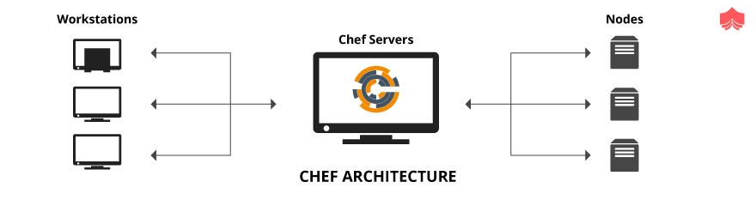
Chef Architecture

Slide 5
Chef Workflow
we need to connect the workstation with the chef-server so that it can upload the cookbooks to the chef-server.
knife is a command-line tool that provides an interface between a workstation and the Chef Server.Using this we can upload cookbooks to chef server.
we need to connect the nodes with the chef server so that they can pull the configuration and deploy/run it on to their server.
when we connect nodes with the chef-server , the process basically installs a chef-client and ohai.
chef-client is an agent that runs locally on every node that is under management by Chef Server.

Slide 6
When Chef Client runs, it performs all of the steps required for bringing a node into the expected state.
Ohai is a tool that is used to collect system configuration data, which is provided to the chef-client for use within cookbooks.
Idempotency - Once chef-client converted code into Infrastructure, then even chef-client runs again, it will not take any action. It won’t do the same task again and again. If any new changes are there in that code, only then chef-client is going to take action. So it doesn’t make any difference ever if you run chef-client any no of times

Slide 7
What is a cookbook
A cookbook is a collection of Chef resources (recipes) that define the desired state of a particular component of your infrastructure. For example, you might have a cookbook for configuring Apache, MySQL, or Nginx.
Recipe is a file that contains a set of instructions (resources) to be executed.

Slide 8
Resource
Describes the desired state for a configuration item.Declares the steps needed to bring that item to the desired state
E.g., package, template, or service
OR
A resource is a Ruby block with four components: a type, a name, one (or more) properties (with values), and one (or more) actions. The syntax for a resource is like this:
type 'name' do attribute 'value' action :type_of_action end

Slide 9
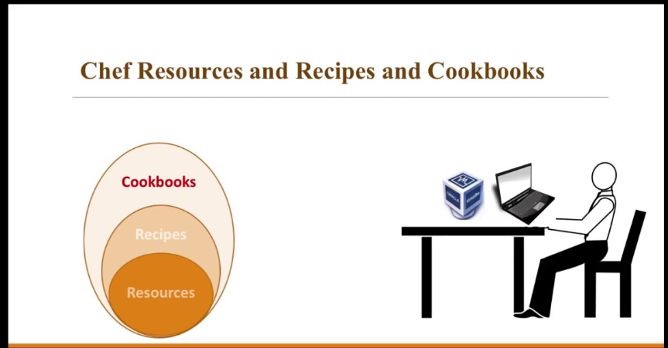

Slide 10
Cookbook1/Recipe1
cron 'chef-client' do
minute '*'
command 'chef-client'
user 'root'
end

Slide 11
Cookbook1/Recipe2
file '/path/to/testfile' do
content 'This is a test file.'
action :create
end

Slide 12
Cookbook2/Recipe1
package 'tar' do version '1.16.1' action :install end
All actions have a default value. Only non-default behaviors of actions and properties need to be specified. For example, the package resource’s default action is :install
package 'tar' do version '1.16.1' end

Slide 13
Chef Resources
https://docs.chef.io/resource/

Slide 14
Install Chef-workstation
Create an ec2 instance-
Go to https://www.chef.io/downloads/tools/workstation?os=amazon Get the link for downloading chef-workstation
wget https://packages.chef.io/files/stable/chef-workstation/23.5.1040/amazon/2/chef-workstation-23.5.1040-1.el7.x86_64.rpm
yum install chef-workstation-23.5.1040-1.el7.x86_64.rpm
chef --version

Slide 15
Generating Cookbook
Login to ec2 and create a directory cookbooks.
cd cookbooks
chef generate cookbook apache-cookbook
ls -ltra apache-cookbook
cd apache-cookbook
chef generate recipe recipe1
chef generate recipe apache-recipe

Slide 16
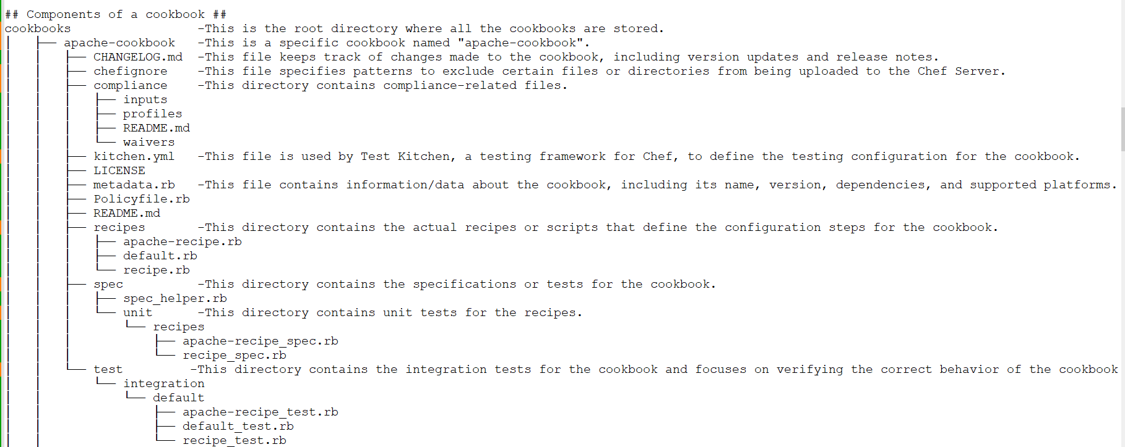
Structure of a Cookbook

Slide 17
Creating recipe
vi apache-cookbook/recipes/recipe1.rb
file 'info_file' do
content 'Hello there..'
action :create
end

Slide 18
Another recipe
vi apache-cookbook/recipes/apache-recipe.rb
package "httpd" do action :install end
file '/var/www/html/index.html' do content 'Created using chef cookbook' action :create end
service 'httpd' do action [:enable, :start] end

Slide 19
How to execute linux command in a chef recipe
execute "run a script" do command <<-EOH mkdir /logs touch /info.txt EOH end

Slide 20
Testing the recipes syntax
chef exec ruby -c <cookbook_name>/recipes/<recipe_name.rb>

Slide 21
Chef in local mode
There are options to run the recipe locally skipping the chef-server
chef-client -zr "recipe[<cookbook_name>::<recipe_name>]"
-z: Specifies that Chef should run in local mode, meaning it operates without a Chef server. It uses the local cookbooks and resources available on the system.

Slide 22
Chef Attributes
An attribute is a specific detail about a node, written in a key=value pair
Attributes are used by Chef Client to determine:
The current state of the node
What was the state of the node at the end of the previous Chef Infra Client run
What should be the state of the node at the end of the current Chef Infra Client run

Slide 23
Using an attribute in a recipe
E.g, Create a folder attributes under your cookbook.
Add attributes/default.rb with below content: default['apache-cookbook']['message'] = 'Hello, Chef ..using attributes!'
#You can use it in your recipe like below
message = node[‘apache-cookbook’]['message']
file '/tmp/my_file.txt' do content message action :create end
Notes:
(In Chef, we can read attribute values in a recipe using the node object. The node object provides access to all the attributes defined in your cookbook)

Slide 24
Attribute Types
default -Has the lowest attribute precedence. Default attributes are defined in cookbooks and roles.
force_default - Takes precedence over a default attribute set by a role or an environment.
normal -A normal attribute has a higher attribute precedence than a default attribute.
override - override attributes are a way to override the default values of attributes defined in a cookbook
force_override -Use the force_override attribute to ensure that an attribute defined in a cookbook (by an attribute file or by a recipe) takes precedence over an override attribute set by a role or an environment.
automatic - Automatic attributes are set by the Chef client.These attributes provide information about the node and its environment, such as hostname, IP address, platform, etc. You can access these attributes directly in your recipes without explicitly defining them. e.g., node['ipaddress'], node['hostname'], node['hostname']

Slide 25
Chef Attributes can be defined by nodes, cookbooks, roles, environments or recipes.
Priority of Attributes:
Here is the order of precedence for Chef attributes:
https://docs.chef.io/attribute_precedence/

Slide 26
Chef recipe using automatic attributes
file '/basicinfo' do content "This is to get attributes HOSTNAME: #{node['hostname']} IPADDRESS: #{node['ipaddress']} MEMORY: #{node['memory']['total']}" owner 'root' group 'root' action :create end
Test the recipe: chef exec ruby -c apache-cookbook/recipes/<recipename.rb>

Slide 27
Chef Server
The hosted Chef Server provided by Chef Software (api.chef.io) is a cloud-based service offered by Chef Software. It is a fully-managed solution that provides all the infrastructure and services needed to run a Chef Server.
With the hosted Chef Server, you don't need to set up and manage your own dedicated EC2 instance for the Chef Server.
Go to manage.chef.io, create an account , clk on organisations-> download starter kit-> extract-> move chef-repo to workstation
Run the below command to verify if your workstation is connected to the chef-server or not. #cd chef-repo #knife ssl check

Slide 28
cd ec2-user/chef-repo/.chef
cat config.rb
This will show you the chef-server-url
Now the workstation is connected to the chef server.

Slide 29
Upload cookbooks to Chef-Server
Create the cookbooks under /home/ec2-user/chef-repo/cookbooks/
cd chef-repo/cookbooks
chef generate cookbook apache-cookbook
cd chef-repo
knife cookbook upload <cookbook_name>
knife cookbook list

Slide 30
Bootstrapping a Node
Process of connecting any node with the chef-server is called bootstrapping.
Bootstrapping installs Ohai and Chef-Client on a target system so that it can run as a client and sets the node up to communicate with a Chef Server.
step 1. Create a ec2 instance to be considered as node. step 2. Copy the private key of the ec2 node to the workstation under chef-repo step 3. Run the below command on Workstation from inside chef-repo
Knife bootstrap <nodeip_add> --ssh-user ec2-user --sudo -i <node_privkey.pem> -N <node_name>
Once the node is connected to chef-server , we can check it using below command:
knife node list

Slide 31
Attach the cookbook and/or recipes with the Node
cd chef-repo
knife node run_list set <node_name> "recipe[apache-cookbook::apache-recipe]"
Check the runlist for node.
knife node show <node_name>

Slide 32
Running/Pulling the changes from Node
Login to your node.
sudo su
chef-client
If you do not want to run the chef-client manually set a cron to run chef-client at a regular interval.

Slide 33
Chef Roles
Roles are a way to define and assign sets of attributes and recipes to nodes.
Roles typically include the following components:
Name: Each role has a unique name that identifies it within the Chef environment.
Run List: The run list defines the list of recipes and/or other roles that should be applied to the node associated with the role.
Attributes: Roles can define and assign attribute values specific to the role.

Slide 34
Create a Role and Upload it to Chef-server
To create a role
cd chef-repo/roles vi devops.rb
name "devops1" description "webserver role" run_list "recipe[apache-cookbook::apache-recipe]","recipe[apache-cookbook::default]"
Now to upload this role to chef-server, run the below command cd chef-role Knife role from file roles/devopsrole.rb
To check the list of roles with chef-server Knife role list

Slide 35
Create a node and attach it with the role
Attach the role with the node that we have created in previous steps .
Run the below command: Knife node run_list set <node_name> “role[role_name]”
To check the list of roles that are attached with the node, use the below command Knife node show <node_name>
Now when we run chef-client from the node, it will run all the recipes/cookbooks associated with the role.

Slide 36
Questions

